Slide 1

Lecture 9.2
Traditional Array Functions - Reading Materials

Slide 2
Study Instructions
In this reading materials, we have provided examples and quick exercises for some commonly used array functions.
Please test these with your local development environment (Visual Studio Code) or repl.it (Please check out the best practices on next page)
You don’t need to remember the exact syntax, input and output of the examples, but you should have an understand what array functions could do for you.
In reality, you can always Google for the function usage, or refer to this notes. But the prerequisite is that you know what are the keywords to search in Google.

Slide 3
How to Use the Sample Code?
In this study materials, we have provided a use case and sample code on each of the page. We would like you to test each of them.
The best way to learn, is to type the whole code again, instead of copy pasting. (That’s why we provided the code as a picture instead of text)
While typing, try to understand the meaning of each line instead of just typing the code line by line. Testing without understanding what you are doing is meaningless.
After testing, try to make changes to the code, and see if the new results is something that you expected.

Slide 4
Array Operations

Slide 5
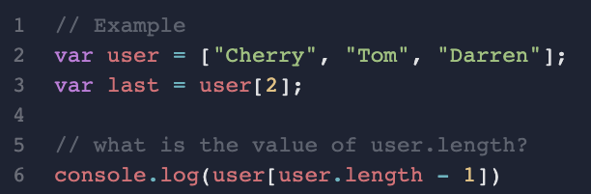
Accessing the array from the last
Sometimes you want to access the data in the array from the back
e.g. retrieve the latest user

Slide 6
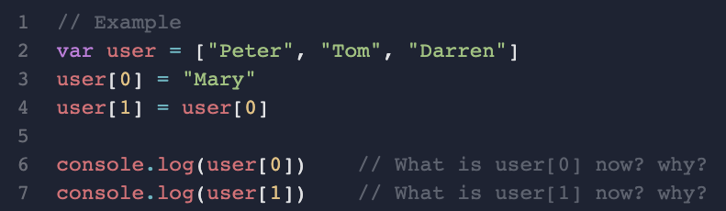
Making changes to the array
Array is mutable, i.e. can be changed
each element is actually a variable that you can re-assign value to it

Slide 7
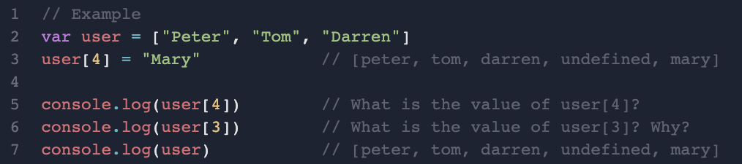
Array doesn’t need to be fully filled
You can set values at any index in the array. For the missing values in between, JS will auto-fill it with "undefined".

Slide 8
Non-mutating Functions

Slide 9
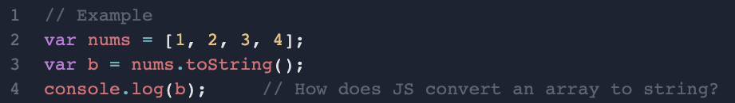
Converting Array to String - toString()

Slide 10
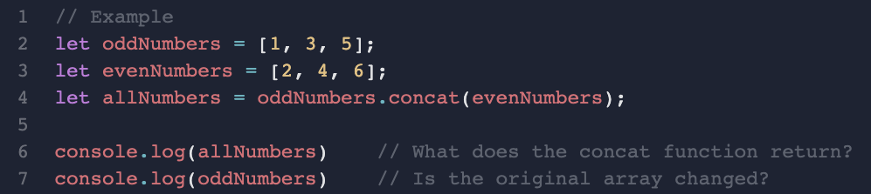
Joining Two Arrays - concat()

Slide 11
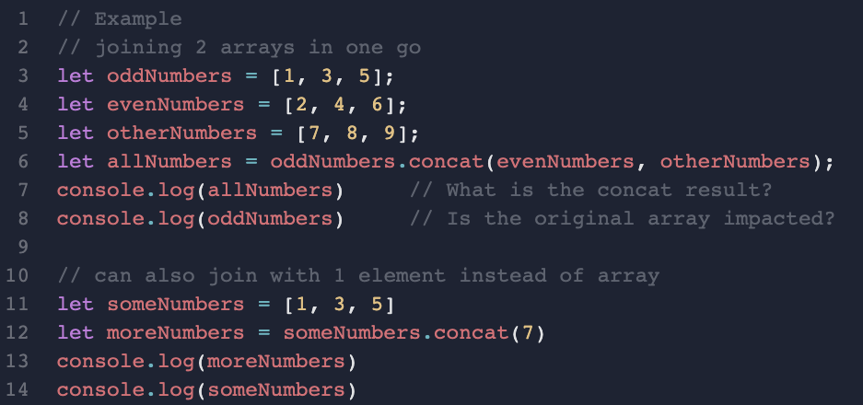
Joining More Arrays - concat()

Slide 12
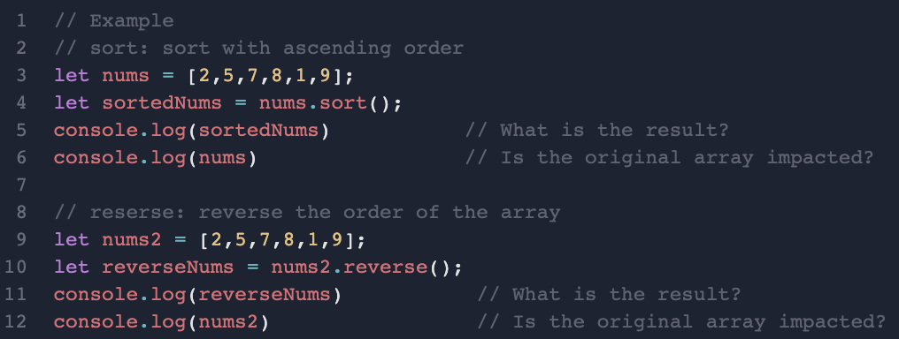
Sort the Array - sort()
// Exercise 1: How to reversely sort an array (from largest to smallest)
// Exercise 2: How to get the smallest number in the array
// Exercise 3: How to get the largest number in the array
Notes:
// Exercise 1: How to reversely sort an array (from largest to smallest)
let reverseSorted = nums.sort().reverse();
// Exercise 2: How to get the smallest number in the array
let smallestNum = nums.sort()[0]
// Exercise 3: How to get the largest number in the array
nums.sort().reverse()[0]
nums.sort()[nums.length-1]

Slide 13
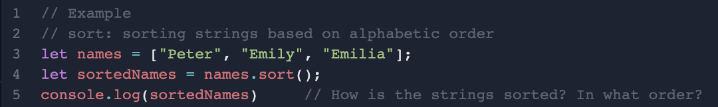
Sorting String Arrays - sort()

Slide 14
Mutating Functions

Slide 15
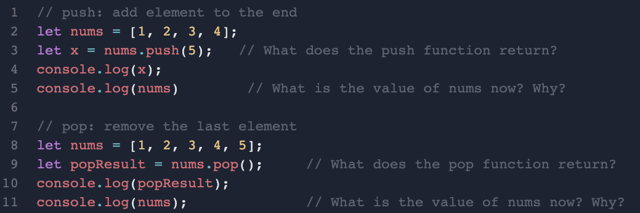
Adding/Removing Items from the End

Slide 16
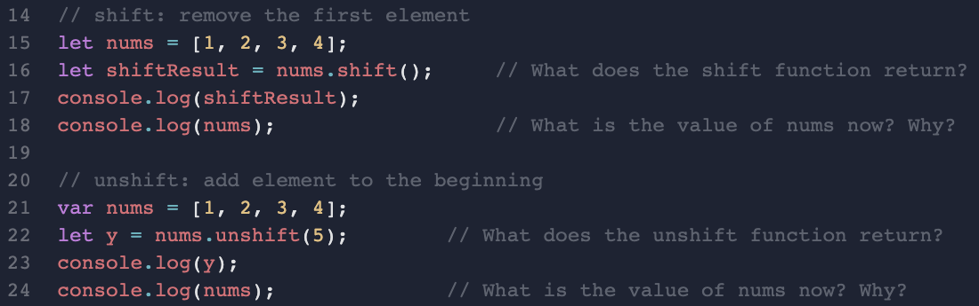
Adding/Removing Items from the Start

Slide 17
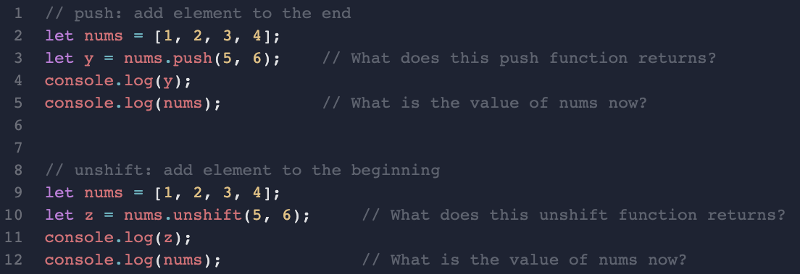
Pushing/Unshifting Multiple Elements

Slide 18
Array of Objects

Slide 19
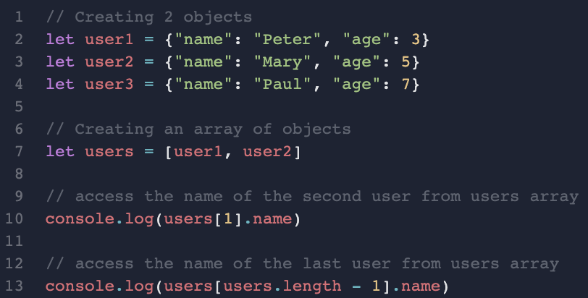
Objects can also be an element
// Exercise 1: How to get the last user’s age?
// Exercise 2: How to push user3 to the end of the array?
// Exercise 3: How to remove the first user from the array?
Notes:
Cue: use repl.it to walk through exercise

